Slide 1
Amazon Sales

Slide 2
Introduction
Objective:
To understand sales trends over the past three years.
Scope:
Helps in identifying seasonal patterns and making data-driven decisions.

Slide 3
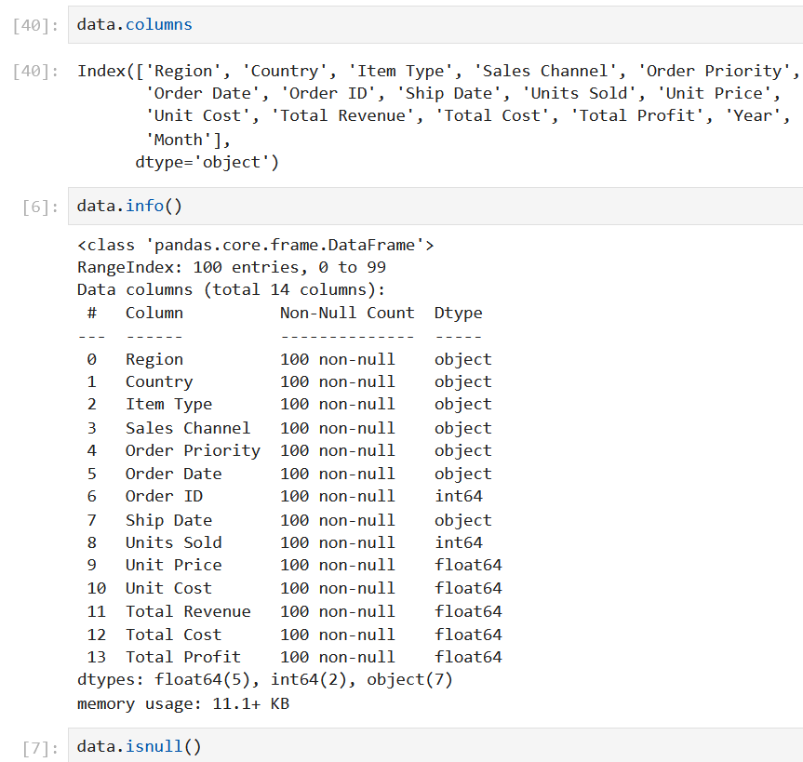
Overview of the ETL Process
EXTRACT
Sales data collected from Amazon's internal systems.
TRANSFORM
Data cleaned, formatted, and categorized by month, year, and product category.
LOAD
Data loaded into a database for analysis.

Slide 4
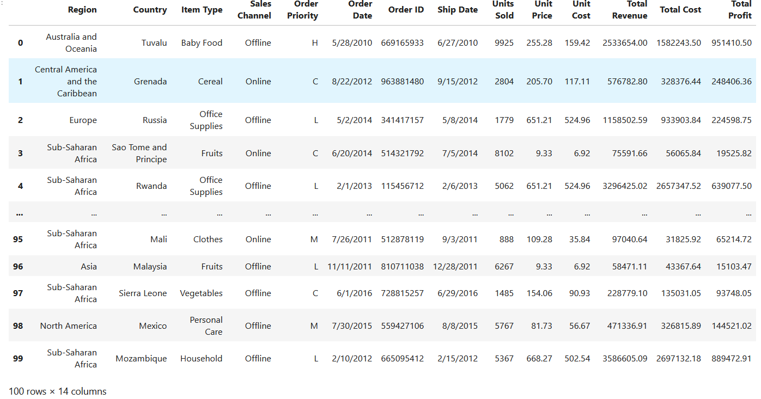
Details of Data
Following is the data provided to do analysis on :-

Slide 5
Main KPIs
Total Sales Revenue
Sales Growth Rate
Distribution of Total Revnue
Monthly Sales Trend
Yearly Sales Trend

Slide 6
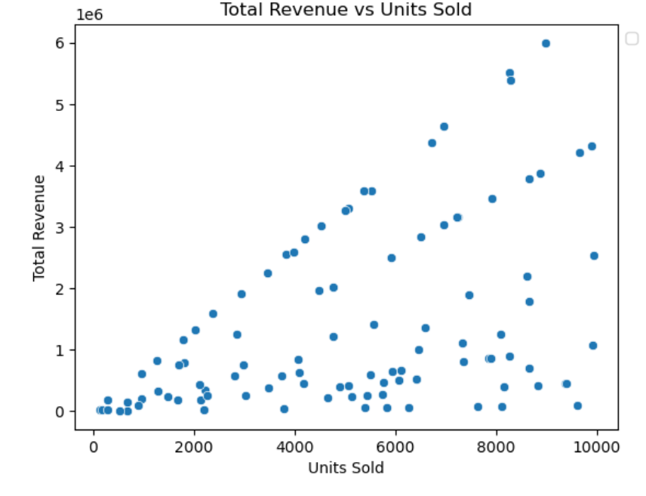
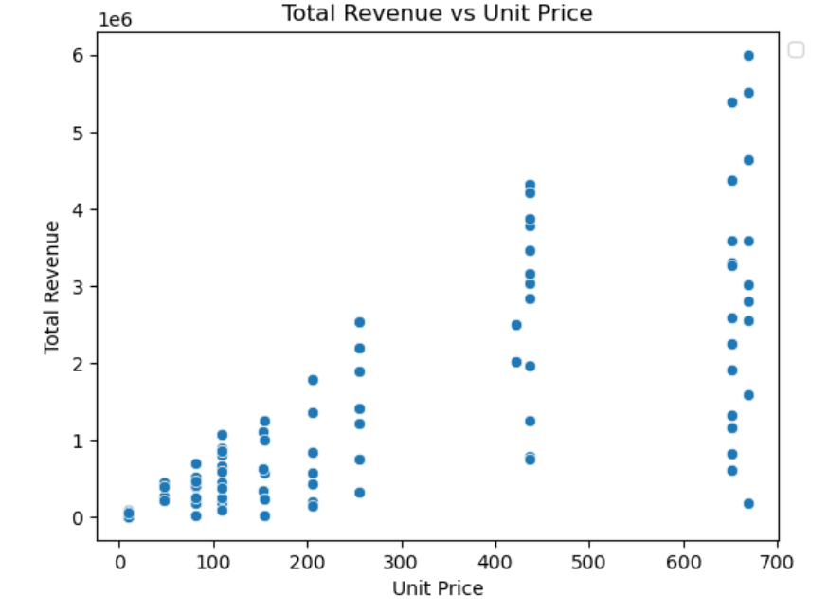
Sales Trends Analysis

Slide 7
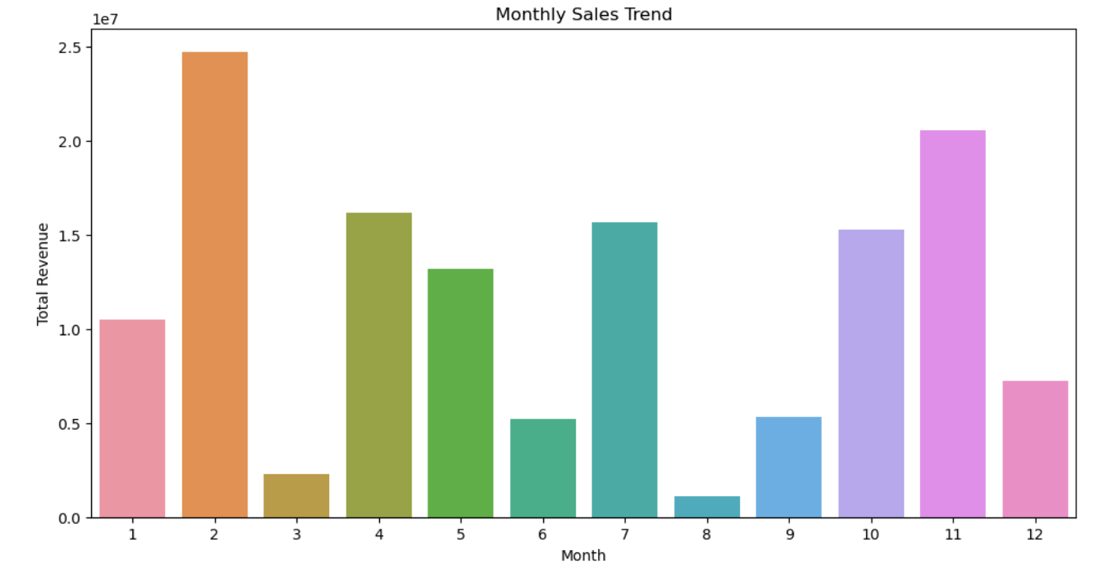
Monthly Sales Trend

Slide 8
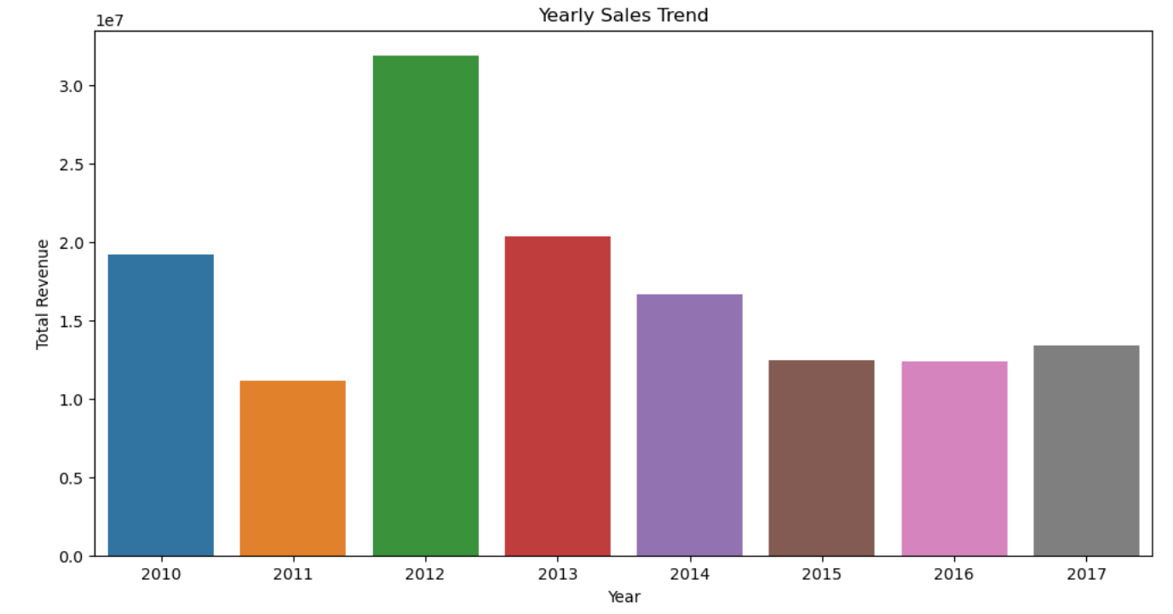
Yearly Sales Trend

Slide 9
Thank You

